Slide 1
VF-C HPA Proposal
Haibin Huang

Slide 2
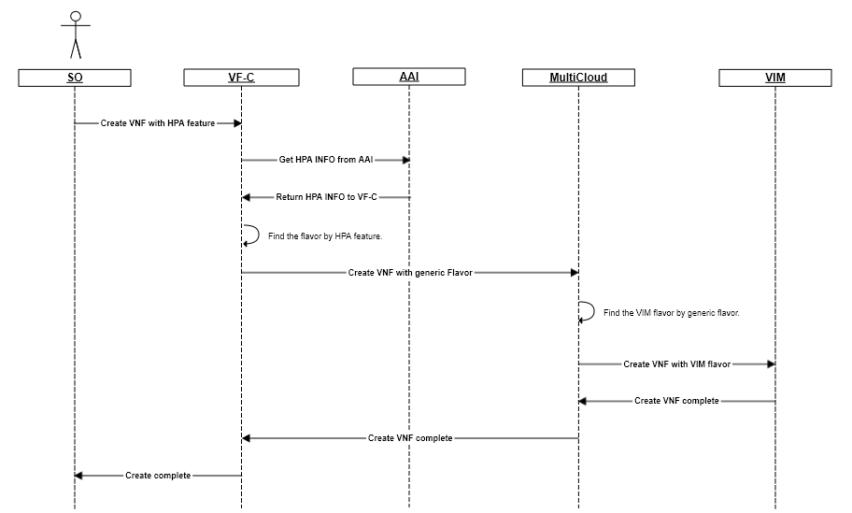
Overall design
VF-C find flavor according to some condition.
CPU>=4
SGX=true

Slide 3
Create VM with HPA feature
Create and Set Aggregate
# nova aggregate-create hm-agg hm-az
# nova aggregate-set-metadata hm-agg HW=high-memory
Add Node to Host Aggregate。
# nova aggregate-add-host hm-agg compute-1 # compute-1 is host name
Create and Set flavor
# nova flavor create hm-test
# nova flavor-key hm-test set HW=high-memory
Create VM
# openstack image list
# nova boot hm-vm --image <image-id> --flavor hm-test
Flavor → Flavor-key → Get aggregate by comparing Flavor-key and metadata → Get Host → Create VM

Slide 4
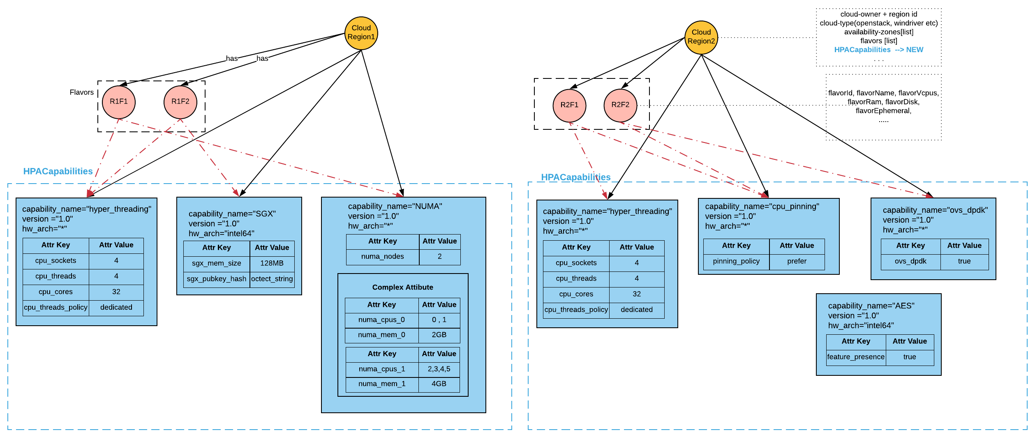
HPA related information in AAI
Link

Slide 5
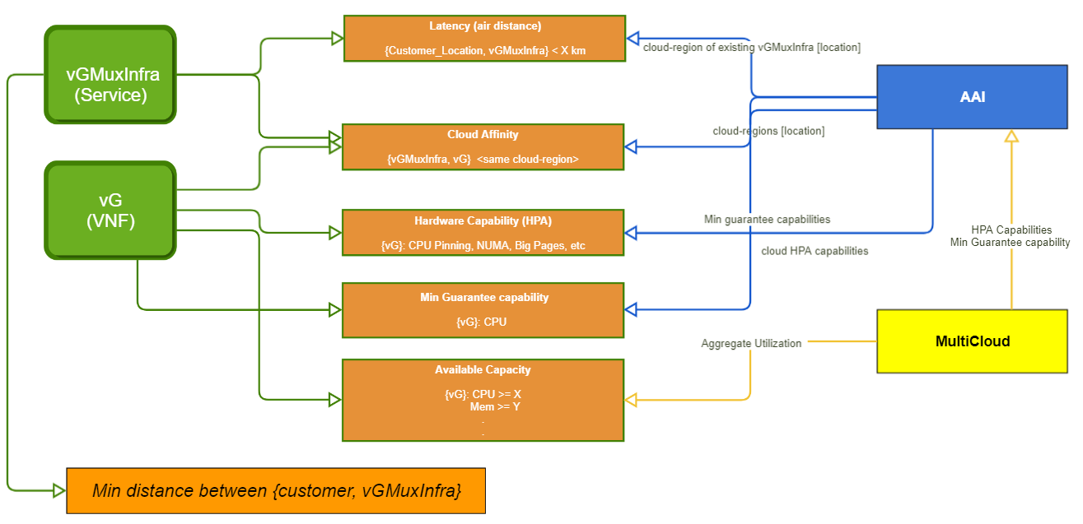
How to OOF Calculate

Slide 6
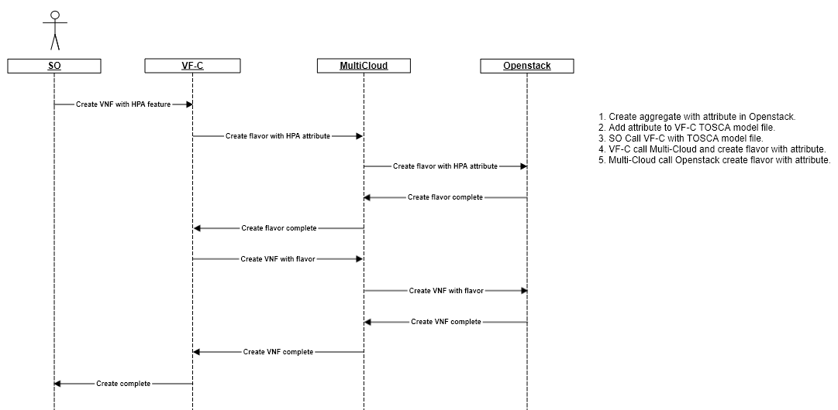
Transition design

Slide 7
Reference
HPA related information in AAI
OOF – MultiCloud interaction in R2

Slide 8
Q&A Thank you!

